Slide 1
Image Compression
By
Kiran TALELE
talelesir@gmail.com
99 870 30 881

Slide 2
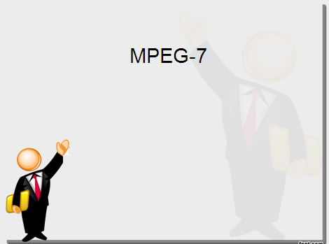

Image Compression
Kiran TALELE
 99870 30 881

Slide 3
Kiran TALELE
@ Bharatiya Vidya Bhavans’ Sardar Patel Institute of Technology Andheri(w) Mumbai
Associate Professor, Electronics Engineering Department (1997)
Dean, Students, Alumni & External Relations (2022)
@ Sardar Patel Technology Business Incubator(SP-TBI),
Funded by Department of Science & Technology(DST),
Govt. of India
Head, Academic Relations (2015)
@ IEEE Bombay Section
Treasurer (2020)
Executive Committee Member (2015)
Kiran TALELE
‹#›

Slide 4
Image Compression
Reduces the number of bits required for storage
Size of the image on Hard Disk is reduced
Coding is essentially representing the information in a more efficient and robust manner
Kiran TALELE
‹#›

Slide 5


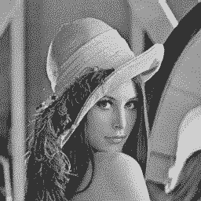
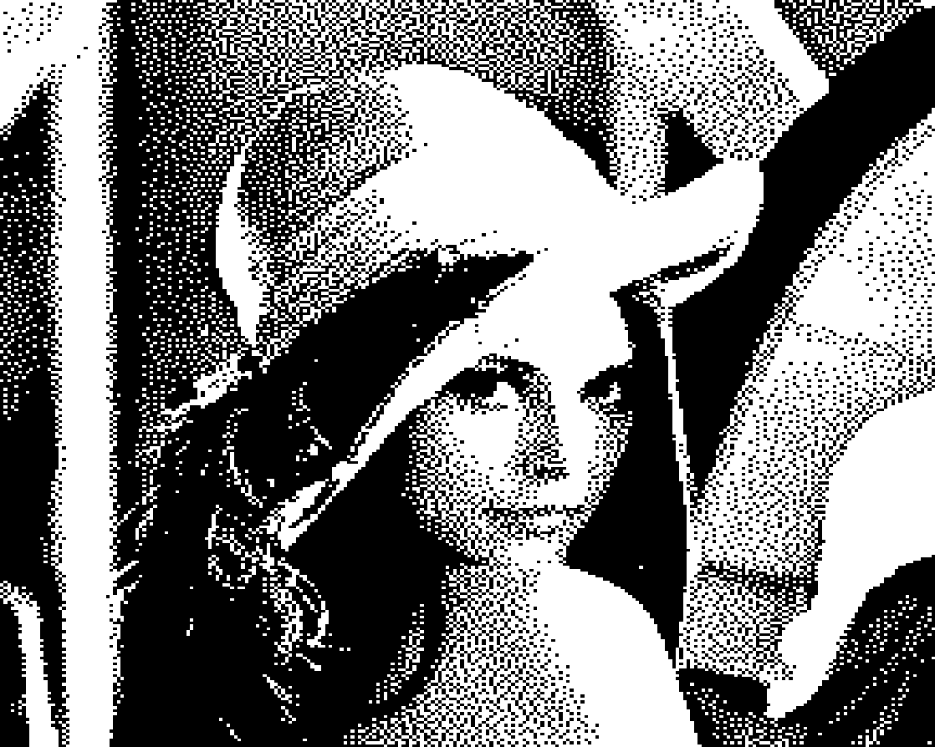
Original BPP = 8
BPP = 4
BPP = 2
BPP = 1
Kiran TALELE
‹#›

Slide 6

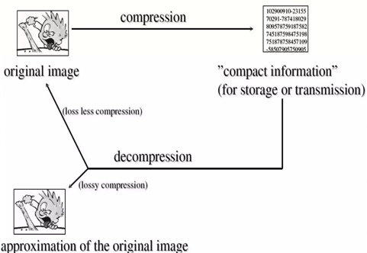
Types of Compression Strategies :
Lossless Compression Techniques
2. Lossy Compression Techniques
Kiran TALELE
‹#›

Slide 7

Types of Compression Strategies :
Lossless Compression Techniques :
1. Arithmetic coding
2. Huffman Coding
3. Run-Length Coding
4. Bit plane Coding : CAC
5. Lossless Predictive coding : DPCM
Removes Redundancies
e.g. Medical Images, Satellite images etc
Kiran TALELE
‹#›

Slide 8
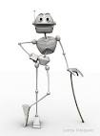
Lossy Compression Techniques :
Useful as very high compression ratios can be achieved with insignificant amount of data loss.
. 1. Improved Gray Scale Quantization
2. Lossy Predictive Coding : Delta Modulation
3. Transform Coding :
JPEG using DCT
DWT based Image Coding
Removes irrelevancies
Quantization
Greater Compression
Kiran TALELE
‹#›

Slide 9
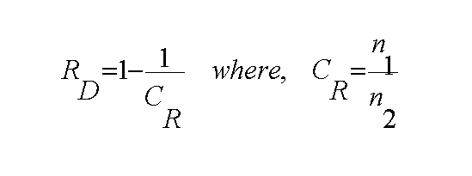
Data Redundancy
Data Redundancy is defined as,
where n1 and n2 denote the number of information-carrying units in the two data sets that represent the same information.
Kiran TALELE
‹#›

Slide 10
Data Redundancy & Compression
DATA = Information + Redundancy
For data reduction or compression we try to reduce three kinds of redundancies present in data
Three approaches :
Reduce Coding Redundancy - some pixel values more common than others.
Reduce Interpixel Redundancy - neighboring pixels have similar values.
Reduce Psychovisual Redundancy - some color differences are imperceptible.
Kiran TALELE
‹#›

Slide 11
1. Interpixel Redundancy
Interpixel redundancy is due to the correlation between the neighboring pixels in an image. That means neighboring pixels are not statistically independent.
The gray levels are not equally probable. The value of any given pixel can be predicated from the value of its neighbors that is they are highly correlated.
The information carried by individual pixel is relatively small.
To reduce the interpixel redundancy the difference between adjacent pixels can be used to represent an image.
Kiran TALELE
‹#›

Slide 12
2. Psychovisual Redundancy
Psychovisual redundancies exist because human perception of the information in an image normally does not involve quantitative analysis of every pixel value in the image.
In general, an observer searches for distinguishing features such as edges or textural regions and mentally combines them into recognizable groupings.
The brain then correlates these groupings with prior knowledge in order to complete the image interpretation process.
Kiran TALELE
‹#›

Slide 13
Psychovisual Redundancy . . . .
Psychovisual redundancy is associated with real or quantifiable visual information. Its elimination is possible only because the information itself is not essential for normal visual processing
Since the elimination of psychovisually redundant data results in a loss of quantitative information, it is commonly referred to as quantization
Kiran TALELE
‹#›

Slide 14
3. Coding Redundancy
Coding redundancy is associated with the representation of information.
The information is represented in the form of codes.
If the gray levels of an image are coded in a way that uses more code symbols than absolutely necessary to represent each gray level then the resulting image is said to contain coding redundancy
Kiran TALELE
‹#›

Slide 15
4. Interpixel Temporal Redundancy
Interpixel temporal redundancy is the statistical correlation between pixels from successive frames in video sequence
Temporal redundancy is also called interframe redundancy. Temporal redundancy can be exploited using motion compensated predictive coding
Removing a large amount of redundancy leads to efficient video compression.
Kiran TALELE
‹#›

Slide 16
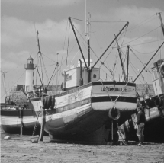
Redundancy
Kiran TALELE
‹#›

Slide 17
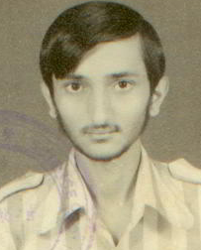
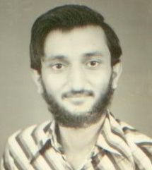
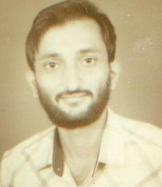
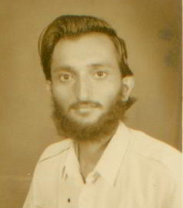
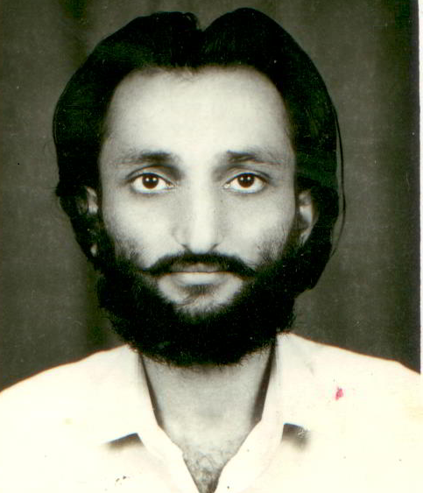
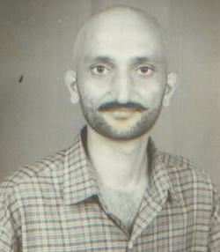
Inter pixel Redundancy-- neighboring pixels have similar values

Slide 18
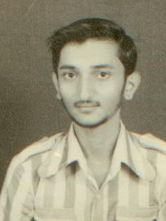
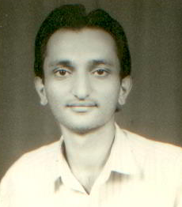
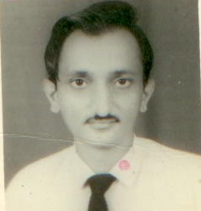
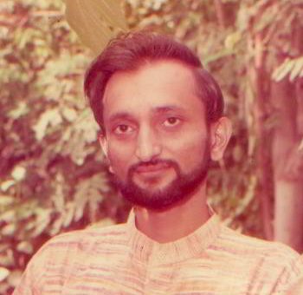
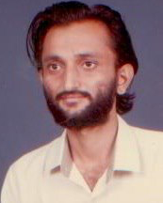
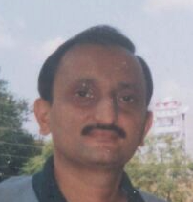

Slide 19
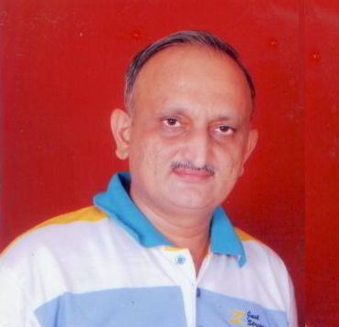
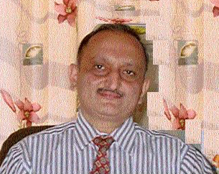
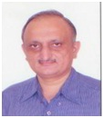
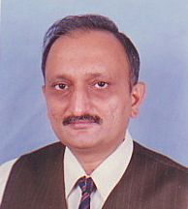
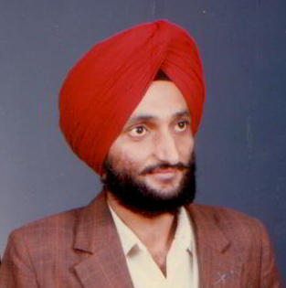
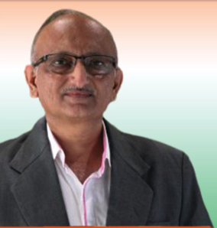
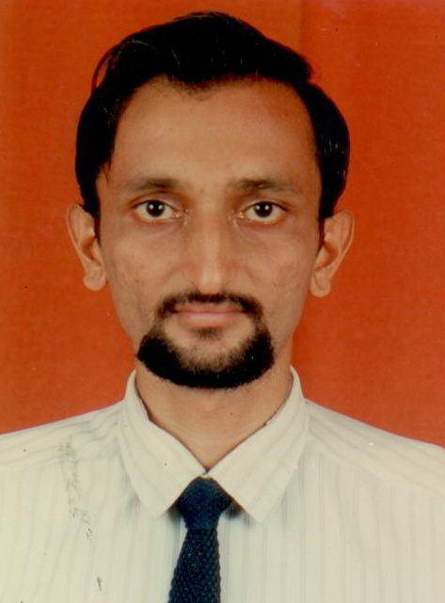
Inter pixel Redundancy-- neighboring pixels have similar values

Slide 20

DPCM Coding Technique exploits
Interpixel Redundancy
Kiran TALELE
‹#›

Slide 21
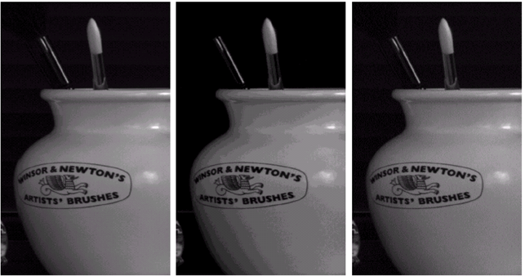
Psycho Visual Redundancy
Input Image
[ 256] Levels
Input Image Uniformly Quantized to [ 16 ] Levels
Input Image IGS Quantized to [16 ] Levels
Kiran TALELE
‹#›

Slide 22

IGS Coding Technique
exploits
Psycho visual Redundancy
Kiran TALELE
‹#›

Slide 23
Coding Redundancy
It is possible to reduce the number bits required for storage using variable length coding technique that depends on statistical parameters of pixels.
Kiran TALELE
‹#›

Slide 24

Huffman Coding and RLE Techniques
exploits
Coding Redundancy
Kiran TALELE
‹#›

Slide 25

Fidelity Criteria
Objective Criteria :
Bits Per Pixel [BPP]
Entropy, Average Length, Efficiency
Mean Square Error [MSE]
Signal to Noise Ratio [SNR]
Peak Signal to Noise Ratio [PSNR]
Subjective Criteria :
: Images are viewed by human beings
Kiran TALELE
‹#›

Slide 26
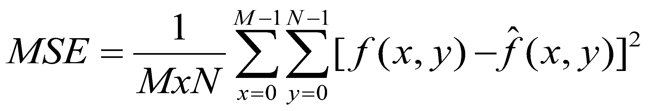
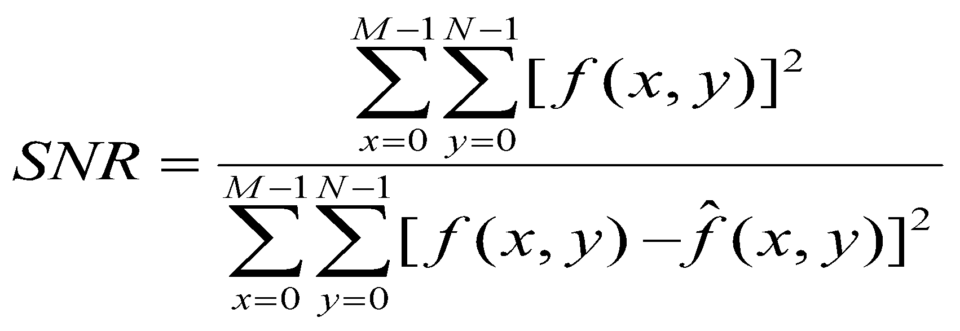
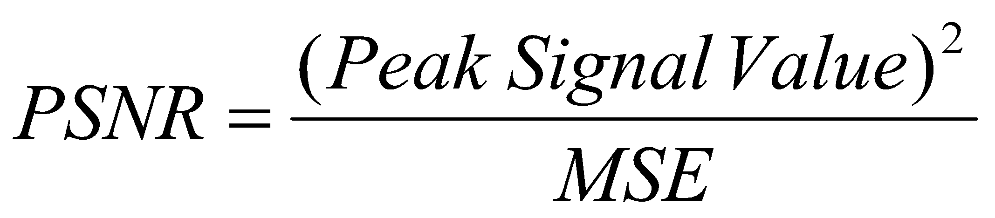
Fidelity Criteria…Objective Criteria :
Mean Square Error [MSE]
2. Signal to Noise Ratio [SNR]
3. Peak Signal to
Noise Ratio [PSNR]
Kiran TALELE
‹#›

Slide 27

Fidelity Criteria…Subjective Criteria :
Subjective Criteria : Images are viewed
by human beings.
1 : Excellent, 2 : Fine,
3 : Passable, 4 : Marginal,
5: Inferior, 6 : Unusable
Evaluations can be done with the following scale.
Kiran TALELE
‹#›

Slide 28
Fidelity Criteria…Subjective Criteria : …...
Value | Rating | Description
1 | Excellent | An image of Extremely High Quality, as Good as you could desire.
2 | Fine | An Image of High Quality, providing enjoyable viewing. Inferior is not objectionable.
3 | Passable | An image of acceptable quality.
4 | Marginal | An image with poor quality; you wish you could improve it. Interference is somewhat objectionable.
5 | Inferior | A very poor quality image, but you could watch it.
6 | Unusable | Image is so bad that you can not watch it.
Kiran TALELE
‹#›

Slide 29
Lossy Compression is NOT suitable for compressing executable files.
Lossless Compression
Arithmetic Coding
Huffman Coding
Run-Length Coding
DPCM Coding

Slide 30
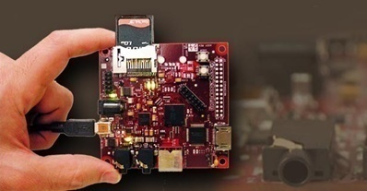
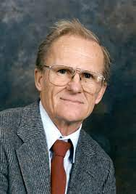
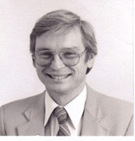
[1] Arithmetic Coding
Arithmetic coding was devel
Arithmetic coding was developed by Jorma Rissanen and Glen Langdon at IBM/Arc in 1977-78
Jorma Rissanen
Ref :
U.S. Patent 4,122,440 – (IBM) Filed 4 March 1977, granted 24 October 1978 – Glen George Langdon, Jorma Johannes Rissanen – Method and means for arithmetic string coding
Glen Langdon

Slide 31

[1] Arithmetic Coding
Example : Message “ I N D I A”
Size of Message = 5 Characters
= 5 Bytes
= 40 bits
Symbol | Probability
I
N
D
A
Kiran TALELE 99870 30 881 talelesir@gmail.com
‹#›

Slide 32
[1] Arithmetic Coding
Example : Message “ I N D I A”
Size of Message = 5 Characters
= 5 Bytes
= 40 bits
Symbol | Probability
I | 0.4
N | 0.2
D | 0.2
A | 0.2
Kiran TALELE 99870 30 881 talelesir@gmail.com
‹#›

Slide 33

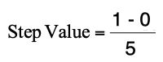

Step-1 : To find interval for first character “ I”
Lower range value = 0
Upper range value = 1
1.0
A
D
N
I
No of sub-intervals = 5
0.8
0.6
0.4
Interval for Character I is
[ 0.0 to 0.4 ]
0.2
0
Kiran TALELE 99870 30 881 talelesir@gmail.com
‹#›
‹#›

Slide 34
Step-2 : To find interval for 2nd character “ N”
Range :
[ 0.0 to 0.4 ]
0.4
0.0
Lower value = 0
Upper value = 0.4
A
D
N
I
0.32
0.24
No of sub-intervals = 5
Step Value = 0.08
0.16
Interval for Character N is [ 0.16 to 0.24 ]
0.08
Kiran TALELE 99870 30 881 talelesir@gmail.com
‹#›

Slide 35
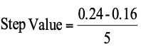
Step-3 : To find interval for 3rd character “ D”
Range : [ 0.16 to 0.24 ]
0.24
0.224
0.208
0.192
0.16
Lower value = 0.16
Upper value = 0.24
A
D
N
I
Step Value = 0.08
Interval for Character D is [ 0.208 to 0.224 ]
Kiran TALELE 99870 30 881 talelesir@gmail.com
‹#›

Slide 36
0.4
0.0
0.224
0.2208
0.2176
0.2144
0.208
A
D
N
I
A
D
N
I

Slide 37
Step-4 : To find interval for 4th character “ I”
Lower value = 0.208
Upper value = 0.224
Range : [ 0.208 to 0.224 ]
0.224
0.2208
0.2176
0.2144
0.208
A
D
N
I
Step Value = 0.032
Interval for Character I is
[ 0.208 to 0.2144]
Kiran TALELE 99870 30 881 talelesir@gmail.com
‹#›

Slide 38
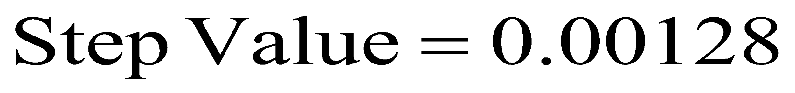
Step-5 : To find interval for 5th character “ A”
Range :
No of sub-intervals = 5
[ 0.208 to 0.2144 ]
0.2144
0.21312
0.21184
0.21056
0.208
A
D
N
I
Interval for Character A is [ 0.21312 to 0.2144 ]
Kiran TALELE 99870 30 881 talelesir@gmail.com
‹#›

Slide 39

Arithmetic Codeword For The Message I N D I A is
0.21312 < Arithmetic Codeword < 0.2144
0.21313
Kiran TALELE 99870 30 881 talelesir@gmail.com
‹#›

Slide 40
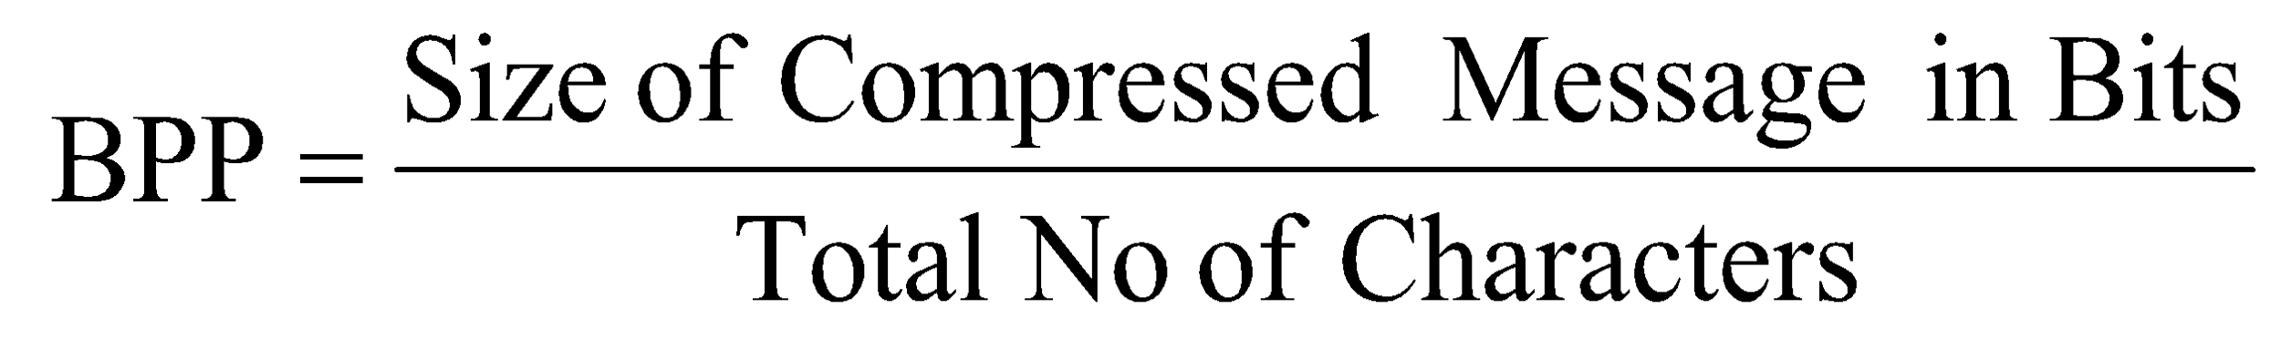
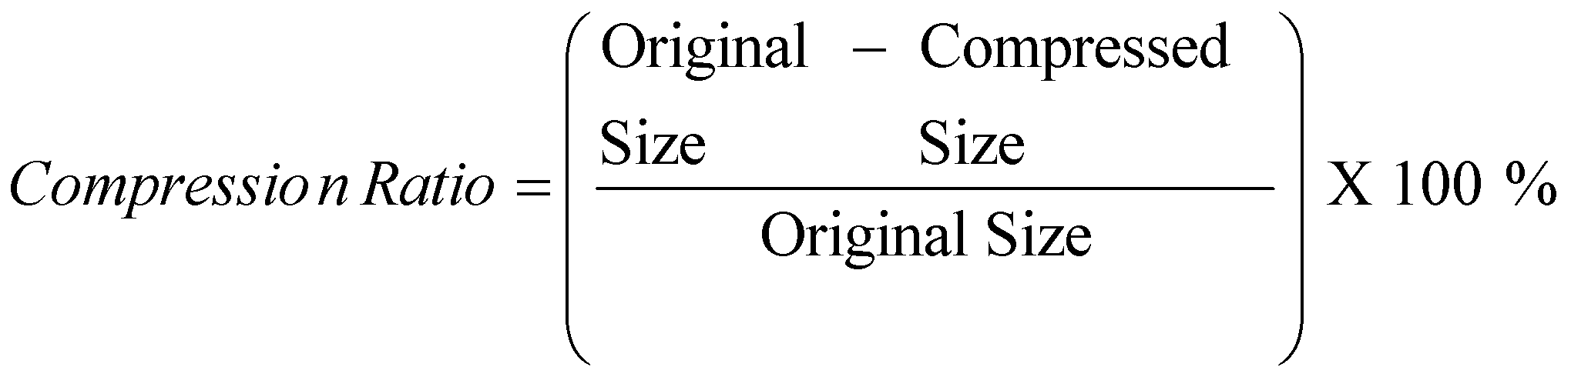
(b) Find BPP and Compression Ratio
(1) To find BPP of Compressed Message :
BPP = 6.2
(2) To find Compression Ratio :
Compression Ratio = 20 %
Kiran TALELE 99870 30 881 talelesir@gmail.com
‹#›

Slide 41

Home Work
Encode the following Message using Arithmetic Coding :
HELLO, JAPAN
Kiran TALELE 99870 30 881 talelesir@gmail.com
‹#›

Slide 42
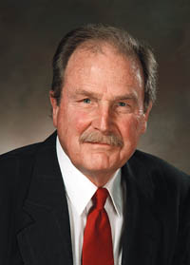
[2] Huffman Coding
Huffman encoding was
invented by David Huffman
in 1952
Ref :
Huffman, D. (1952). "A Method for the Construction of Minimum-Redundancy Codes" (PDF). Proceedings of the IRE. 40 (9):
doi:10.1109/JRPROC.1952.273898.
August 9, 1925
To
October 7, 1999

Slide 43
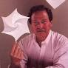
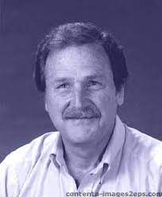
The Story of Huffman Coding
The story of the invention of Huffman codes is a great story that demonstrates that students can
also do better than other professionals
David Huffman (1925-1999) was a research student in an Electrical Engineering course in 1951 in MIT USA. His professor, Robert Fano, assigned his class a project to develop an optimal compression scheme (without mentioning this was a difficult and unsolved problem).
David's solution, published in his paper A Method for the Construction of Minimum-Redundancy Codes is one of the most-cited papers in all of information theory.
Kiran TALELE 99870 30 881 talelesir@gmail.com
‹#›

Slide 44

[2] Huffman Coding
Example-1 :
Consider a Message :
C O M M I T T E E M E E T
Symbol | Probability
C
O
M
I
T
E
Blank
Kiran TALELE 99870 30 881 talelesir@gmail.com
‹#›

Slide 45
[2] Huffman Coding
Example-1 :
Consider a Message :
C O M M I T T E E M E E T
Symbol | Probability
C | ¹/₁₄
O | ¹/₁₄
M | ³/₁₄
I | ¹/₁₄
T | ³/₁₄
E | ⁴/₁₄
Blank | ¹/₁₄
‹#›
Kiran TALELE 99870 30 881 talelesir@gmail.com

Slide 46
Find Huffman Tree :
E | 4/14
M | 3/14
T | 3/14
C | 1/14
O | 1/14
I | 1/14
Blank | 1/14
‹#›
Kiran TALELE 99870 30 881 talelesir@gmail.com

Slide 47
Find Huffman Tree :
E | 4/14 | 4/14
M | 3/14 | 3/14
T | 3/14 | 3/14
C | 1/14 | 2/14
O | 1/14 | 1/14
I | 1/14 | 1/14
Blank | 1/14
‹#›
Kiran TALELE 99870 30 881 talelesir@gmail.com

Slide 48
Find Huffman Tree :
E | 4/14 | 4/14 | 4/14
M | 3/14 | 3/14 | 3/14
T | 3/14 | 3/14 | 3/14
C | 1/14 | 2/14 | 2/14
O | 1/14 | 1/14 | 2/14
I | 1/14 | 1/14
Blank | 1/14
‹#›
Kiran TALELE 99870 30 881 talelesir@gmail.com

Slide 49
Find Huffman Tree :
E | 4/14 | 4/14 | 4/14 | 4/14
M | 3/14 | 3/14 | 3/14 | 4/14
T | 3/14 | 3/14 | 3/14 | 3/14
C | 1/14 | 2/14 | 2/14 | 3/14
O | 1/14 | 1/14 | 2/14
I | 1/14 | 1/14
Blank | 1/14
‹#›
Kiran TALELE 99870 30 881 talelesir@gmail.com

Slide 50
Find Huffman Tree :
E | 4/14 | 4/14 | 4/14 | 4/14 | 6/14
M | 3/14 | 3/14 | 3/14 | 4/14 | 4/14
T | 3/14 | 3/14 | 3/14 | 3/14 | 4/14
C | 1/14 | 2/14 | 2/14 | 3/14
O | 1/14 | 1/14 | 2/14
I | 1/14 | 1/14
Blank | 1/14
‹#›
Kiran TALELE 99870 30 881 talelesir@gmail.com

Slide 51
Find Huffman Tree :
E | 4/14 | 4/14 | 4/14 | 4/14 | 6/14 | 8/14
M | 3/14 | 3/14 | 3/14 | 4/14 | 4/14 | 6/14
T | 3/14 | 3/14 | 3/14 | 3/14 | 4/14
C | 1/14 | 2/14 | 2/14 | 3/14
O | 1/14 | 1/14 | 2/14
I | 1/14 | 1/14
Blank | 1/14
‹#›
Kiran TALELE 99870 30 881 talelesir@gmail.com

Slide 52
Find Huffman Tree :
O
E | 4/14 | 4/14 | 4/14 | 4/14 | 6/14 | 8/14
M | 3/14 | 3/14 | 3/14 | 4/14 | 4/14 | 6/14
T | 3/14 | 3/14 | 3/14 | 3/14 | 4/14
C | 1/14 | 2/14 | 2/14 | 3/14
O | 1/14 | 1/14 | 2/14
I | 1/14 | 1/14
Blank | 1/14
O
1
O
1
O
1
O
1
O
1
1
‹#›
Kiran TALELE 99870 30 881 talelesir@gmail.com

Slide 53
Find Symbol Codewords :
Symbol | Probability P_{K} | Code-word | Length of Codeword L_{k}
E | 4/14 | 01 | 2
M | 3/14 | 10 | 2
T | 3/14 | 11 | 2
C | 1/14 | 0000 | 4
O | 1/14 | 0001 | 4
I | 1/14 | 0010 | 4
Blank | 1/14 | 0011 | 4
Kiran TALELE 99870 30 881 talelesir@gmail.com
‹#›

Slide 54
* Find Code Word of the Message:
Message and Codeword :
C O M M I T T E E B M E E T
0000 0001 10 10 1110 11 11 01 01 0011 10 01 01 11
Encoded Message is then given by : 000000011010111011110101001110010111
Size of Encoded Message : 36 bits
Kiran TALELE 99870 30 881 talelesir@gmail.com
‹#›

Slide 55
(b) Find BPP and Compression Ratio
(1) To find BPP of Compressed Message :
BPP = 36/14 == 2.57
(2) To find Compression Ratio :
Compression Ratio = 67.85 %
Kiran TALELE 99870 30 881 talelesir@gmail.com
‹#›

Slide 56
Example -2 :
Symbol | Probability
F =
Symbol | Probability
10 10 65 20
75 20 30
20 30 44 50
50 44 30 10
Size of Input Image : 128 bits
Kiran TALELE 99870 30 881 talelesir@gmail.com
‹#›

Slide 57
Example -2 :
Symbol | Probability
F =
Symbol | Probability
S₁ = 10
S₃ = 20
S₅ = 30
S₆ = 44
S₇ = 50
S₂ = 65
S₄ = 75
10 10 65 20
75 20 30
20 30 44 50
50 44 30 10
Size of Input Image : 128 bits
Kiran TALELE 99870 30 881 talelesir@gmail.com
‹#›

Slide 58
Example -2 :
Symbol | Probability
F =
Symbol | Probability
S₁ = 10 | 4/16
S₃ = 20 | 3/16
S₅ = 30 | 3/16
S₆ = 44 | 2/16
S₇ = 50 | 2/16
S₂ = 65 | 1/16
S₄ = 75 | 1/16
10 10 65 20
75 20 30
20 30 44 50
50 44 30 10
Size of Input Image : 128 bits
Kiran TALELE 99870 30 881 talelesir@gmail.com
‹#›

Slide 59
Find Huffman Tree :
O
S₁ | 4/16 | 4/16 | 4/16 | 5/16 | 7/16 | 9/16
S₃ | 3/16 | 3/16 | 4/16 | 4/16 | 5/16 | 7/16
S₅ | 3/16 | 3/16 | 3/16 | 4/16 | 4/16
S₆ | 2/16 | 2/16 | 3/16 | 3/16
S₇ | 2/16 | 2/16 | 2/16
S₂ | 1/16 | 2/16
S₄ | 1/16
O
1
O
1
O
1
O
1
O
1
1

Slide 60
Symbol Codewords :
Symbol S_{K} | Probability P_{K} | Code-word C_{K} | Length of Codeword L_{k}
S₁ = 10 | 4/16 | 1 0 | 2
S₃ = 20 | 3/16 | 1 1 | 2
S₅ = 30 | 3/16 | 0 0 0 | 3
S₆ = 44 | 2/16 | 0 1 0 | 3
S₇ = 50 | 2/16 | 0 1 1 | 3
S₂ = 65 | 1/16 | 0 0 1 0 | 4
S₄ = 75 | 1/16 | 0 0 1 1 | 4
Kiran TALELE 99870 30 881 talelesir@gmail.com
‹#›

Slide 61
Symbol Codewords Table :
F =
10 10 65 20
75 20 30
20 30 44 50
50 44 30 10
Symbol | Code-word
S₁ = 10 | 1 0
S₃ = 20 | 1 1
S₅ = 30 | 0 0 0
S₆ = 44 | 0 1 0
S₇ = 50 | 0 1 1
S₂ = 65 | 0 0 1 0
S₄ = 75 | 0 0 1 1
F =
10 | 10 | 0010 | 11
10 | 0011 | 11 | 000
11 | 000 | 010 | 011
011 | 010 | 000 | 10
Encoded Image is then given by :
1010001011100011110001100001001101101000010
Size of Encoded Image : 43 bits
Kiran TALELE 99870 30 881 talelesir@gmail.com
‹#›

Slide 62
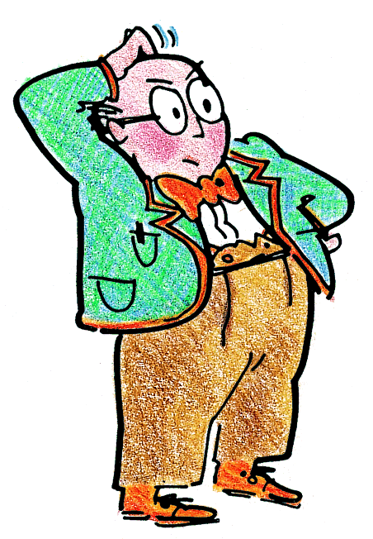
(b) Find BPP, Compression Ratio and Efficiency.
…BPP …Compression Ratio..Efficiency
…but what do they mean??
Kiran TALELE 99870 30 881 talelesir@gmail.com
‹#›

Slide 63
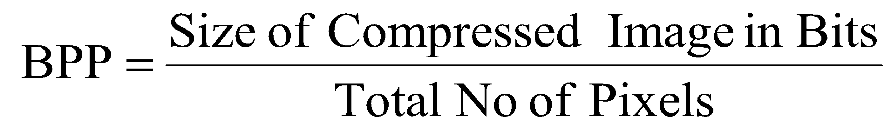
(b) Find Bits Per Pixel, Compression Ratio and Efficiency.
(1) To find BPP of Compressed Image :
BPP = 43/16
BPP = 2.687
Kiran TALELE 99870 30 881 talelesir@gmail.com
‹#›

Slide 64
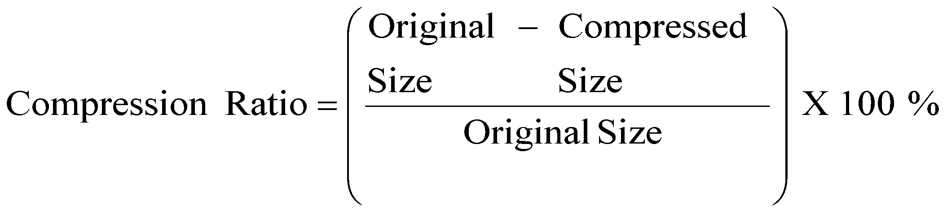
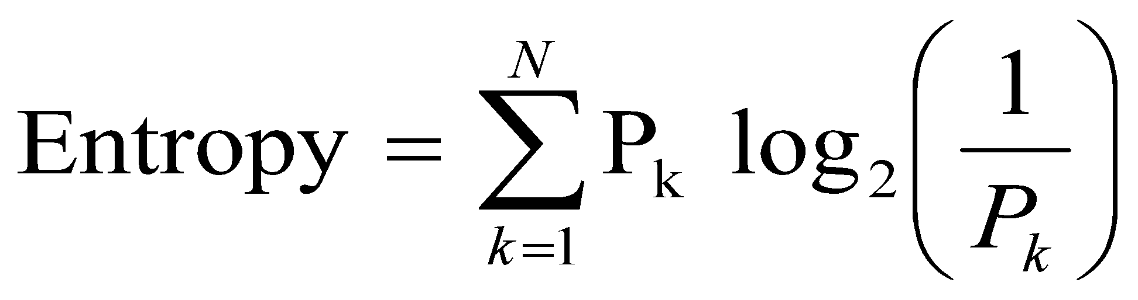
(2) To find Compression Ratio :
Compression Ratio = 66.41 %
(3) To find Entropy:
Entropy = 2.6537
Kiran TALELE 99870 30 881 talelesir@gmail.com
‹#›

Slide 65
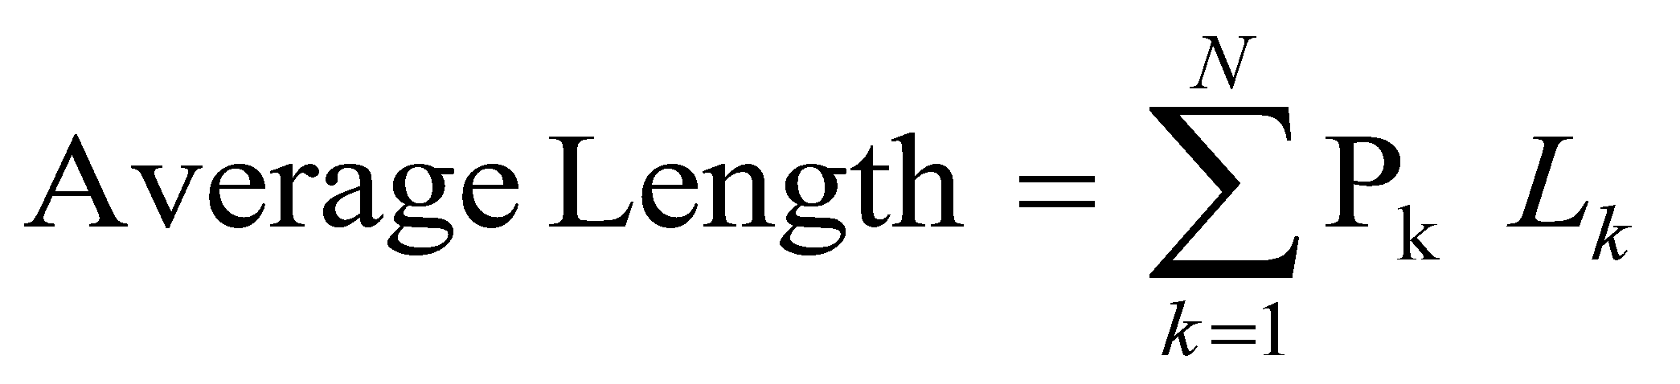
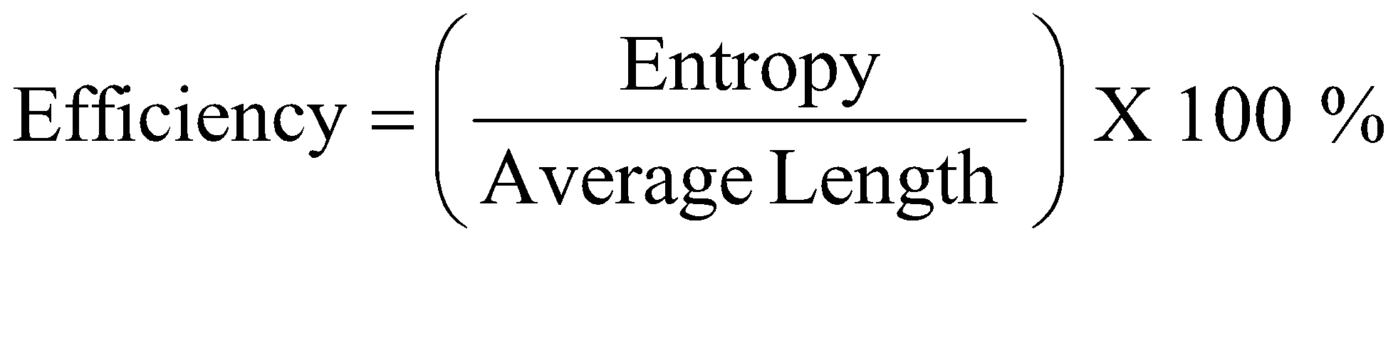
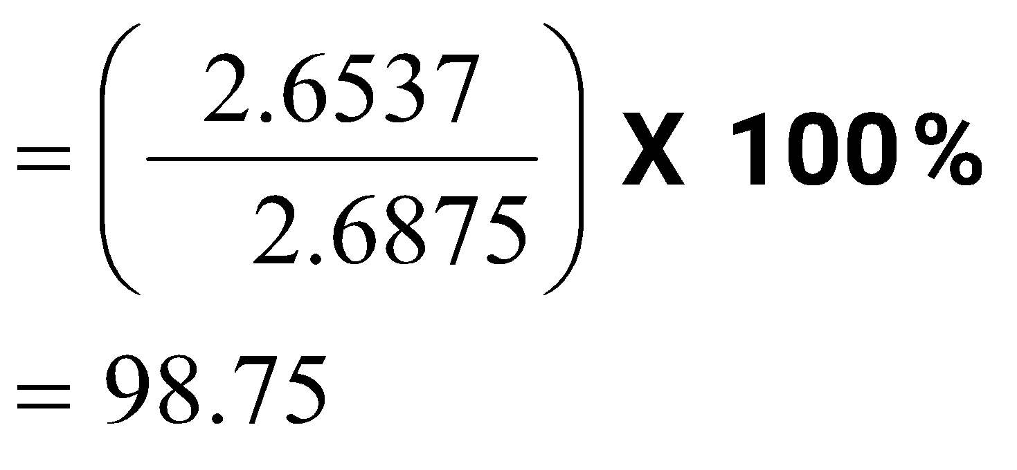
(4) To find Average Length :
Average Length = 2.6875
(5) To find Efficiency :
Kiran TALELE 99870 30 881 talelesir@gmail.com
‹#›

Slide 66

Home Work
Encode the following Message using Huffman Coding :
M I C R O P R O C E S S O R
C O M M U N I C A T I O N
COMMITTEE MEET TOMORROW
Kiran TALELE 99870 30 881 talelesir@gmail.com
‹#›

Slide 67

Run
Length
Encoding

Slide 68
[3] Run Length Coding
Run Length Coding was patented by Hitachi in 1983
Hitachi, Ltd. is a Japanese multinational electronics company headquartered in Chiyoda, Tokyo.

Slide 69
[3] Run-Length Encoding
RLE consists of repetitive sequence of Tokens
Size of Token is Two Bytes.
Each Token consists of two words :
1. Pixel Value
2. Consecutive occurrence of
Pixel value.

Slide 70
Example -1 :
F =
RLE coded image is :
0, 6,
Size of RLE Coded Image: bytes
Size of input Image is : bytes
Image is compressed
Compression Ratio = %
0 0 0 0 0
0 8 8 8 0
0 8 8 8 2
2 2 2 2 0
0 0 0 0 0
Kiran TALELE 99870 30 881 talelesir@gmail.com
‹#›

Slide 71
Example -1 :
F =
RLE coded image is :
0, 6, 8, 3,
Size of RLE Coded Image: bytes
Size of input Image is : bytes
Image is compressed
Compression Ratio = %
0 0 0 0 0
0 8 8 8 0
0 8 8 8 2
2 2 2 2 0
0 0 0 0 0
Kiran TALELE 99870 30 881 talelesir@gmail.com
‹#›

Slide 72
Example -1 :
F =
RLE coded image is :
0, 6, 8, 3, 0, 2,
Size of RLE Coded Image: bytes
Size of input Image is : bytes
Image is compressed
Compression Ratio = %
0 0 0 0 0
0 8 8 8 0
0 8 8 8 2
2 2 2 2 0
0 0 0 0 0
Kiran TALELE 99870 30 881 talelesir@gmail.com
‹#›

Slide 73
Example -1 :
F =
RLE coded image is :
0, 6, 8, 3, 0, 2, 8, 3, 2, 5, 0, 6
Size of RLE Coded Image: 12 bytes
Size of input Image is : 25 bytes
Image is compressed
Compression Ratio = 52 %
0 0 0 0 0
0 8 8 8 0
0 8 8 8 2
2 2 2 2 0
0 0 0 0 0
Kiran TALELE 99870 30 881 talelesir@gmail.com
‹#›

Slide 74
Example -2 :
F =
0 0 0 0 0
1 8 8 8 2
2 8 8 8 0
0 1 2 2 1
5 0 2 1 4
RLE coded image is =
0, 5, 1, 1, 8, 3, 2, 2, 8, 3
0, 2, 1, 1, 2, 2, 1, 1, 5, 1
3, 1, 2, 1, 1, 1, 4, 1
RLE coded image Size : 30 Bytes
Size of input Image is : 25 Bytes
Image is NOT Compressed
Here, size of the RLE coded image is larger than size of input image. That means every time RLE does not give compression.
Kiran TALELE 99870 30 881 talelesir@gmail.com
‹#›

Slide 75

RLE does not give compression every time.
RLE is effective compression technique when pixel value is repeated consecutively.
In the overall image if the pixel value is not repeated consecutively large number of times, RLE cannot give compression

Slide 76
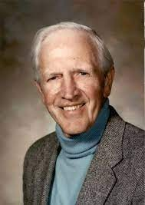
[4] Differential PCOM (DPCM)
DPCM was invented by
C. Chapin Cutler at
Bell Labs in 1950
Reference:
U.S. patent 2605361, C. Chapin Cutler, "Differential Quantization of Communication Signals", filed June 29, 1950, issued July 29, 1952
Dec 16, 1914
To
Dec 1, 2002

Slide 77
Cassius Chapin Cutler (December 16, 1914 – December 1, 2002) was an American electrical engineer at Bell Labs.
His notable achievements include the invention of the corrugated waveguide and differential pulse-code modulation (DPCM).
He was born on December 16, 1914 in Springfield, Massachusetts to Paul A. Cutler and Myra Chapin. He received the B.S. degree in electrical engineering from Worcester Polytechnic Institute in 1937. On September 27, 1941 he married Virginia Tyler in Waterford, Maine.
In 1979 Cutler left Bell Labs to become a professor of applied physics at Stanford University.
Kiran TALELE 99870 30 881 talelesir@gmail.com
‹#›

Slide 78
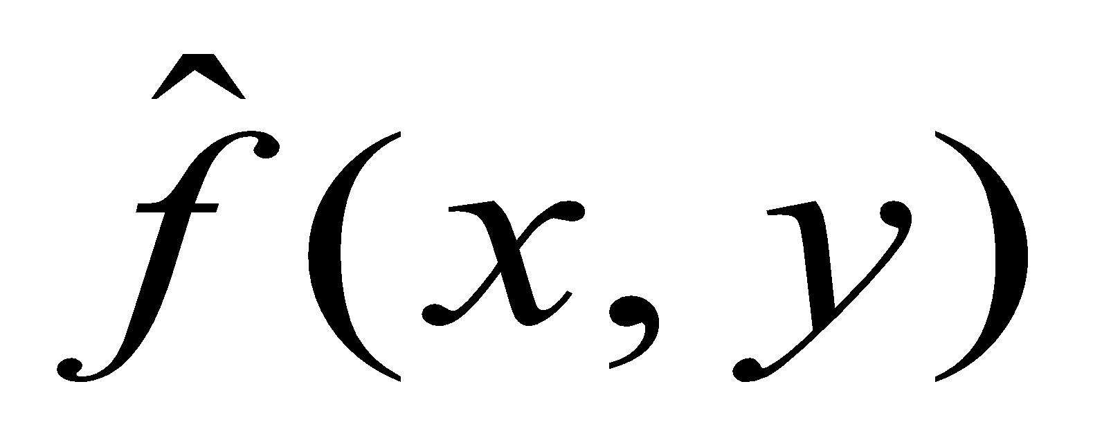
[4] Lossless Predictive Coding : Differencial PCM
(a) DPCM Encoder
+
e(x,y)
DPCM Encoded output
f(x,y)
Input
Image
Pixel
f(x,y)
Source Encoder
-
Predictor
(Delay)
f(x,y) |  | e(x,y)
102 | 0 | 102
100 | 102 | -2
104 | 100 | 4
103 | 104 | -1
99 | 103 | -4
98 | 99 | -1
104 | 98 | 6
100 | 104 | -4
102 | 100 | 2
Input Image :
A =
100 104
99 98
100 102
DPCM Image :
A =
-2 4
-1 -4 -1
6 -4 2

Slide 79
Lossless Predictive Coding : Differencial PCM
(b) DPCM Decoder
DPCM coded Input
e(x,y)
Source
Encoder
f(x,y)
Reconstructed Input Image
Predictor
(Delay)
f(x,y)
e(x,y) |  | f(x,y)
102 | 0 | 102
-2 | 102 | 100
4 | 100 | 104
-1 | 104 | 103
-4 | 103 | 99
-1 | 99 | 98
6 | 98 | 104
-4 | 104 | 100
2 | 100 | 102
Decoded Image :
B =
100 104
99 98
100 102
Kiran TALELE 99870 30 881 talelesir@gmail.com
‹#›

Slide 80
Lossy Compression
. 1. Improved Gray Scale Quantization
2. Lossy Predictive Coding : Delta Modulation
3. Transform Coding :
JPEG using DCT
DWT based Image Coding

Slide 81

Lossy Image Compression System
Source Encoder
An Encoder is for Image Compression. A variety of linear transforms are available like :
Discrete Fourier Transform (DFT),
Discrete Cosine Transform (DCT),
Discrete Wavelet Transform (DWT).
Kiran TALELE 99870 30 881 talelesir@gmail.com
‹#›

Slide 82
Quantizer :
It is used to approximate the input coefficient value so that it can be compressed efficiently.
Quantization: a process of representing a large – possible infinite – set of values with a much smaller set.
Scalar quantization: a mapping of an input value x into a finite number of output values, y: Q: x → y
Kiran TALELE 99870 30 881 talelesir@gmail.com
‹#›

Slide 83

Improved Gray Scale [IGS]Quantization

Slide 84
Example :
Consider a Digital Image
A =
26 41
10 25
57 54 06
(a) Find 3 bit IGS coded Image.
Kiran TALELE 99870 30 881 talelesir@gmail.com
‹#›

Slide 85
Pixel | Pixel in 6 bit Binary | Sum 000 000 | IGS Code
12 | 0 0 1 1 0 0
26 | 0 1 1 0 1 0
41 | 1 0 1 0 0 1
13 | 0 0 1 1 0 1
10 | 0 0 1 0 1 0
25 | 0 1 1 0 0 1
57 | 1 1 1 0 0 1
54 | 1 1 0 1 1 0
06 | 0 0 0 1 1 0
Kiran TALELE 99870 30 881 talelesir@gmail.com
‹#›

Slide 86
Pixel | Pixel in 6 bit Binary | Sum 000 000 | IGS Code
12 | 0 0 1 1 0 0 | 0 0 1 1 0 0
26 | 0 1 1 0 1 0
41 | 1 0 1 0 0 1
+ 1 0 0
0 1 1 1 1 0
0 1 1 1 1 0
+ 1 1 0
1 0 1 1 1 1
1 0 1 1 1 1
Kiran TALELE 99870 30 881 talelesir@gmail.com
‹#›

Slide 87
Pixel | Pixel in 6 bit Binary | Sum 000 000 | IGS Code
12 | 0 0 1 1 0 0 | 0 0 1 1 0 0
26 | 0 1 1 0 1 0 | 0 1 1 1 1 0
41 | 1 0 1 0 0 1 | 1 0 1 1 1 1
13 | 0 0 1 1 0 1
10 | 0 0 1 0 1 0
25 | 0 1 1 0 0 1
57 | 1 1 1 0 0 1
54 | 1 1 0 1 1 0
06 | 0 0 0 1 1 0
Kiran TALELE 99870 30 881 talelesir@gmail.com
‹#›

Slide 88
Pixel | Pixel in 6 bit Binary | Sum 000 000 | IGS Code
12 | 0 0 1 1 0 0 | 0 0 1 1 0 0
26 | 0 1 1 0 1 0 | 0 1 1 1 1 0
41 | 1 0 1 0 0 1 | 1 0 1 1 1 1
13 | 0 0 1 1 0 1 | 0 1 0 1 0 0
10 | 0 0 1 0 1 0
25 | 0 1 1 0 0 1
57 | 1 1 1 0 0 1
54 | 1 1 0 1 1 0
06 | 0 0 0 1 1 0
Kiran TALELE 99870 30 881 talelesir@gmail.com
‹#›

Slide 89
Pixel | Pixel in 6 bit Binary | Sum 000 000 | IGS Code
12 | 0 0 1 1 0 0 | 0 0 1 1 0 0
26 | 0 1 1 0 1 0 | 0 1 1 1 1 0
41 | 1 0 1 0 0 1 | 1 0 1 1 1 1
13 | 0 0 1 1 0 1 | 0 1 0 1 0 0
10 | 0 0 1 0 1 0 | 0 0 1 1 1 0
25 | 0 1 1 0 0 1
57 | 1 1 1 0 0 1
54 | 1 1 0 1 1 0
06 | 0 0 0 1 1 0
Kiran TALELE 99870 30 881 talelesir@gmail.com
‹#›

Slide 90
Pixel | Pixel in 6 bit Binary | Sum 000 000 | IGS Code
12 | 0 0 1 1 0 0 | 0 0 1 1 0 0
26 | 0 1 1 0 1 0 | 0 1 1 1 1 0
41 | 1 0 1 0 0 1 | 1 0 1 1 1 1
13 | 0 0 1 1 0 1 | 0 1 0 1 0 0
10 | 0 0 1 0 1 0 | 0 0 1 1 1 0
25 | 0 1 1 0 0 1 | 0 1 1 1 1 1
57 | 1 1 1 0 0 1 | 1 1 1 0 0 1
54 | 1 1 0 1 1 0 | 1 1 0 1 1 1
06 | 0 0 0 1 1 0 | 1 1 1 1 0 1
Kiran TALELE 99870 30 881 talelesir@gmail.com
‹#›

Slide 91
Pixel | Pixel in 6 bit Binary | Sum 000 000 | IGS Code
12 | 0 0 1 1 0 0 | 0 0 1 1 0 0 | 0 0 1
26 | 0 1 1 0 1 0 | 0 1 1 1 1 0
41 | 1 0 1 0 0 1 | 1 0 1 1 1 1
13 | 0 0 1 1 0 1 | 0 1 0 1 0 0
10 | 0 0 1 0 1 0 | 0 0 1 1 1 0
25 | 0 1 1 0 0 1 | 0 1 1 1 1 1
57 | 1 1 1 0 0 1 | 1 1 1 0 0 1
54 | 1 1 0 1 1 0 | 1 1 0 1 1 1
06 | 0 0 0 1 1 0 | 1 1 1 1 0 1
Kiran TALELE 99870 30 881 talelesir@gmail.com
‹#›

Slide 92
Pixel | Pixel in 6 bit Binary | Sum 000 000 | IGS Code
12 | 0 0 1 1 0 0 | 0 0 1 1 0 0 | 0 0 1
26 | 0 1 1 0 1 0 | 0 1 1 1 1 0 | 0 1 1
41 | 1 0 1 0 0 1 | 1 0 1 1 1 1 | 1 0 1
13 | 0 0 1 1 0 1 | 0 1 0 1 0 0
10 | 0 0 1 0 1 0 | 0 0 1 1 1 0
25 | 0 1 1 0 0 1 | 0 1 1 1 1 1
57 | 1 1 1 0 0 1 | 1 1 1 0 0 1
54 | 1 1 0 1 1 0 | 1 1 0 1 1 1
06 | 0 0 0 1 1 0 | 1 1 1 1 0 1
Kiran TALELE 99870 30 881 talelesir@gmail.com
‹#›

Slide 93
Pixel | Pixel in 6 bit Binary | Sum 000 000 | IGS Code
12 | 0 0 1 1 0 0 | 0 0 1 1 0 0 | 0 0 1
26 | 0 1 1 0 1 0 | 0 1 1 1 1 0 | 0 1 1
41 | 1 0 1 0 0 1 | 1 0 1 1 1 1 | 1 0 1
13 | 0 0 1 1 0 1 | 0 1 0 1 0 0 | 0 1 0
10 | 0 0 1 0 1 0 | 0 0 1 1 1 0 | 0 0 1
25 | 0 1 1 0 0 1 | 0 1 1 1 1 1 | 0 1 1
57 | 1 1 1 0 0 1 | 1 1 1 0 0 1 | 1 1 1
54 | 1 1 0 1 1 0 | 1 1 0 1 1 1 | 1 1 0
06 | 0 0 0 1 1 0 | 1 1 1 1 0 1 | 1 1 1
Kiran TALELE 99870 30 881 talelesir@gmail.com
‹#›

Slide 94
(b) Find Decoded Image.
Input Image.
IGS Coded pixel value | Decoded Pixel in 6 bit Binary | Output Pixel Value
0 0 1
0 1 1
1 0 1
0 1 0
0 0 1
0 1 1
1 1 1
1 1 0
1 1 1
A =
26 41
10 25
57 54 06
Encoded Image.
001 011 101
010 001 011
111 110 111
Kiran TALELE 99870 30 881 talelesir@gmail.com
‹#›

Slide 95
(b) Find Decoded Image.
Input Image.
IGS Coded pixel value | Decoded Pixel in 6 bit Binary | Output Pixel Value
0 0 1 | 0 0 1 0 0 0
0 1 1 | 0 1 1 0 0 0
1 0 1 | 1 0 1 0 0 0
0 1 0 | 0 1 0 0 0 0
0 0 1 | 0 0 1 0 0 0
0 1 1 | 0 1 1 0 0 0
1 1 1 | 1 1 1 0 0 0
1 1 0 | 1 1 0 0 0 0
1 1 1 | 1 1 1 0 0 0
A =
26 41
10 25
57 54 06
Encoded Image.
001 011 101
010 001 011
111 110 111
Kiran TALELE 99870 30 881 talelesir@gmail.com
‹#›

Slide 96
(b) Find Decoded Image.
Input Image.
IGS Coded pixel value | Decoded Pixel in 6 bit Binary | Output Pixel Value
0 0 1 | 0 0 1 0 0 0 | 8
0 1 1 | 0 1 1 0 0 0 | 24
1 0 1 | 1 0 1 0 0 0 | 40
0 1 0 | 0 1 0 0 0 0 | 16
0 0 1 | 0 0 1 0 0 0 | 8
0 1 1 | 0 1 1 0 0 0 | 24
1 1 1 | 1 1 1 0 0 0 | 56
1 1 0 | 1 1 0 0 0 0 | 48
1 1 1 | 1 1 1 0 0 0 | 56
A =
26 41
10 25
57 54 06
Encoded Image.
001 011 101
010 001 011
111 110 111
Decoded Image.
B =
24 40
8 24
48 56
Kiran TALELE 99870 30 881 talelesir@gmail.com
‹#›

Slide 97

(b) Find BPP, Compression Ratio, MSE, SNR and PSNR
(1) To find BPP of Compressed Image :
BPP = 27/9
BPP = 3
Kiran TALELE 99870 30 881 talelesir@gmail.com
‹#›

Slide 98

(2) To find Compression Ratio :
Compression Ratio = 50 %
(3) To find Mean Square Error [MSE]
MSE =

Slide 99


(4) To find Signal to Noise Ratio [SNR]
SNR =
(5). To find Peak Signal to Noise Ratio [PSNR]
PSNR =

Slide 100
Psycho visual Redundancy
Brightness of a region is perceived by the ye that does not depend on the absolute grey level values. This is because the human eye does not respond with equal sensitivity to all visual information. Some information is visually more important than others. Information which is not visually important is called Psychovisual Redundancy.
Psychovisual redundancies exist in all images and are eliminated without hampering the subjective quality of image.
Simply reducing the quantization i.e. number of bits of representation, compress the image but also produces false contouring.
I.G.S. coding reduces the quantization but also reduces false contouring.
Kiran TALELE 99870 30 881 talelesir@gmail.com
‹#›

Slide 101
Input Image
[ 256] Levels
Input Image Uniformly Quantized to [ 16 ] Levels
Input Image IGS Quantized to [ 16 ] Levels
Kiran TALELE 99870 30 881 talelesir@gmail.com
‹#›

Slide 102

Lossy Compression
. 1. Improved Gray Scale Quantization
2. Lossy Predictive Coding : Delta Modulation
3. Transform Coding :
JPEG using DCT
DWT based Image Coding
Kiran TALELE 99870 30 881 talelesir@gmail.com
‹#›

Slide 103

JPEG Still Image Compression

Slide 104

JPEG Encoder
Quality Scale
DCT
Quantizer
Entropy Coding
Headers
Tables
Data
Qunatization Tables
Coding Tables
Kiran TALELE 99870 30 881 talelesir@gmail.com
‹#›

Slide 105
An Input image is first divided into pixel blocks of size 8 x 8 which are processed left to right, top to bottom.
Each block of 8 x 8 pixel size is level shifted by subtracting the quantity 2^{n-1} where 2^{n}is the highest gray value (ie for n = 8 , 2 ^{n} = 256).
Kiran TALELE 99870 30 881 talelesir@gmail.com
‹#›

Slide 106

The 2D DCT of the block is then computed and quantized.
Quantized DCT coefficients are reordered using the zigzag pattern to form a 1D sequence of quantized coefficients.
Kiran TALELE 99870 30 881 talelesir@gmail.com
‹#›

Slide 107
Non-zero AC coefficients are coded using a variable length code that defines the coefficients value and the number of preceding zeros.
DC coefficients are the difference coded relative to the DC coefficient of the previous sub-image.
Kiran TALELE 99870 30 881 talelesir@gmail.com
‹#›

Slide 108

JPEG Coding Example Contd
The picture is divided in 8x8 blocks
Kiran TALELE 99870 30 881 talelesir@gmail.com
‹#›

Slide 109
JPEG Coding Example …
Input Image : ( 8 x 8 ) Size Block
52 55 61 66 70 61 64 73
63 59 66 90 109 85 69 72
62 59 68 113 144 104 66 73
63 58 71 122 154 106 70 69
67 61 68 104 126 88 68 70
79 65 60 70 77 68 58 75
85 71 64 59 55 61 65 83
87 79 69 68 65 76 78 94
Kiran TALELE 99870 30 881 talelesir@gmail.com
‹#›

Slide 110
JPEG Coding Example …
After 128 Deduction :
-76 - 73 - 67 - 62 - 58 - 67 - 64 - 55
-65 - 69 - 62 - 38 - 19 - 43 - 59 - 56
-66 - 69 - 60 - 15 16 - 24 - 62 - 55
-65 - 70 - 57 - 6 26 - 22 - 58 - 59
-61 - 67 - 60 - 24 - 2 - 40 - 60 - 58
-49 - 63 - 68 - 58 - 51 - 65 - 70 - 53
-43 - 57 - 64 - 69 - 73 - 67 - 63 - 45
-41 - 49 - 59 - 60 - 63 - 52 - 50 - 34
Kiran TALELE 99870 30 881 talelesir@gmail.com
‹#›

Slide 111
After DCT :
-415 - 29 - 62 25 55 - 20 -1 3
7 - 21 - 62 9 11 -7 - 6 6
- 46 8 77 -25 -30 10 7 -5
- 50 13 35 -15 - 9 6 0 3
11 - 8 -13 - 2 - 1 1 - 4 1
- 10 1 3 - 3 - 1 0 2 -1
-4 - 1 2 - 1 2 - 3 1 - 2
- 1 - 1 - 1 - 2 - 1 - 1 0 - 1
Kiran TALELE 99870 30 881 talelesir@gmail.com
‹#›

Slide 112
Zigzag Scaning of Quantized DCT Coeffs.
After quantization:
-26 -3 –6 2 2 0 0 0 1 -2 –4 0 0 0 0 0 –3 1 5 –1 –1 0 0 0 –4 1 2 -1 0 0 0 0 1 0 0 0 0 0 0 0 0 0 0 0 0 0 0 0 0 0 0 0 0 0 0 0 0 0 0 0 0 0 0 0
After zigzag scan:
[ - 26 -3 1 -3 -2 -6 2 -4 1 -4 1 1 5 0 2
0 0 -1 2 0 0 0 0 0 -1 -1 EOB]
Represent Each number with its Value, Run and Size

Slide 113

DPCM of DC Coefficient
Kiran TALELE 99870 30 881 talelesir@gmail.com
‹#›

Slide 114
JPEG Coding Example Contd.
After zigzag scan:
[ - 26 - 3 1 - 3 - 2 - 6 2 - 4 1 - 4 1 1 5
0 2 0 0 - 1 2 0 0 0 0 0 -1 -1 EOB]
After DPCM of DC coefficient (assuming previous DC value of -17):
[ - 9 - 3 1 - 3 - 2 - 6 2 - 4 1 - 4 1 1 5
0 2 0 0 - 1 2 0 0 0 0 0 -1 -1 EOB]
After RLC:
[ -9 (0,-3) (0,1) (0,-3) (0,-2) (0,-6) (0,2) (0,-4) (0,1) (0,-4) (0,1)
(0,1) (0,5) (1,2) (2,-1) (0,2) (5,-1) (0,-1) EOB]
After VLC: 1010110 0100 001 0100 0101 100001 0110 100011 001 100011 001 001 100101 11100110 110110 0110 11110100 0001010
Total Bits : 92 Total Pixels : 64 Bits/Pixel : 1.43 Compression Ratio : 5.6
Kiran TALELE 99870 30 881 talelesir@gmail.com
‹#›

Slide 115
JPEG Coding Example Contd.
After inverse quantization:
416 - 33 - 60 32 48 0 0 0 12 - 24 - 56 0 0 0 0 0 - 42 13 80 - 24 - 40 0 0 0 - 56 17 44 - 29 0 0 0 0 18 0 0 0 0 0 0 0 0 0 0 0 0 0 0 0 0 0 0 0 0 0 0 0 0 0 0 0 0 0 0 0
Kiran TALELE 99870 30 881 talelesir@gmail.com
‹#›

Slide 116
JPEG Coding Example Contd.
After IDCT:
- 70 - 64 - 61 - 64 - 69 - 66 - 58 - 50 - 72 - 73 - 61 - 39 - 30 - 40 - 54 - 59 - 68 - 78 - 58 - 9 13 - 12 - 48 - 64 - 59 - 77 - 57 0 22 - 13 - 51 - 60 - 54 - 75 - 64 - 23 - 13 - 44 - 63 - 56 - 52 - 71 - 72 - 54 - 54 - 71 - 71 - 54 45 - 59 - 70 - 68 - 67 - 67 - 61 - 50 - 35 - 47 - 61 - 66 - 60 - 48 - 44 - 44
Kiran TALELE 99870 30 881 talelesir@gmail.com
‹#›

Slide 117
JPEG Coding Example Contd.
After level shift by +128:
58 64 67 64 59 62 70 78 56 55 67 89 98 88 74 69 60 50 70 119 141 116 80 64 69 51 71 128 149 115 77 68 4 53 64 105 115 84 65 72 6 57 56 74 75 57 57 74 83 69 59 60 61 61 67 78 93 81 67 62 69 80 84 84
Kiran TALELE 99870 30 881 talelesir@gmail.com
‹#›

Slide 118
JPEG Coding Example Contd.
Error:
- 6 - 9 - 6 2 11 - 1 - 6 - 5 7 4 - 1 1 11 - 3 - 5 3 2 9 - 2 - 6 - 3 - 12 - 14 9 - 6 7 0 - 4 - 5 - 9 - 7 1 - 7 8 4 - 1 11 4 3 - 2 3 8 4 - 4 2 11 1 1 2 2 5 - 1 - 6 0 - 2 5 - 6 - 2 2 6 - 4 - 4 - 6 10
Kiran TALELE 99870 30 881 talelesir@gmail.com
‹#›

Slide 119
JPEG Performance
Bits/pixel >= 2 1.5 0.75 0.5 0.25 | Quality Indistinguishable Excellent Very Good Good Fair | Compression Ratio 8-to-1 10.7-to-1 21.4-to-1 32-to-1 64-to-1

Slide 120
JPEG Decoder
Entropy Coding
Quantizer
DCT
Headers
Tables
Data
Coding Tables
Qunatization Tables
Kiran TALELE 99870 30 881 talelesir@gmail.com
‹#›

Slide 121

Kiran TALELE 99870 30 881 talelesir@gmail.com
‹#›

Slide 122




Dr. Kiran TALELE
Academic : PhD
Professional :
Dean-Students, Alumni & External Relations @ Bharatiya Vidya Bhavans’ Sardar Patel Institute of Technology (SP-IT), Mumbai
Head-Academic Relation @ Sardar Patel Technology Business Incubator (SP-TBI), Mumbai
Treasurer-IEEE Bombay Section
091-9987030881
kiran.talele@spit.ac.in / ktvtalele@gmail.com
https://www.linkedin.com/in/k-t-v-talele/
www.facebook.com/Kiran-Talele-1711929555720263
Stay Connected
‹#›
‹#›

Slide 123
Dr. Kiran TALELE is an Associate Professor in Electronics & Telecommunication Engineering Department of Bharatiya Vidya Bhavans’ Sardar Patel Institute of Technology, Mumbai with 33+ years experience in Academics.
He is a Dean of Students, Alumni and External Relations at Sardar Patel Institute of Technology, Andheri Mumbai.
He is also a Head of Sardar Patel Technology Business Incubator, Mumbai.
His area of research is Digital Signal & Image Processing, Computer Vision, Machine Learning and Multimedia System Design.
He has published 85+ research papers at various national & international refereed conferences and journals. He has filed published 25+ patents at Indian Patent Office. One patent is granted in 2021.
He is a Treasurer of IEEE Bombay Section and Mentor for Startup Incubation & Intellectual Asset Creation.
He is a recipient of P.R. Bapat IEEE Bombay Section Outstanding Volunteer Award 2019.

